Slide 1
Group Project #1
Group #4: Trenton Noel, Atuwatse Okorodudu, Bria Woodard, Zoe Williams

Slide 2
Dataset Overview: Movies
Our dataset was a large collection of movie-related information. This was a large dataset that included nearly 10,000,000 movies. Key attributes:
Title & Overview
Ratings & Votes
Financials
Genre & popularity
Language & Production

Slide 3
Dataset Quality
Shortcomings of the dataset
Unnecessary variables included such as overview and production country
Significant null values are included in voter turnout and voter average
Media that were not movies was included in the dataset

Slide 4
Ingestion + Wrangling Tasks
Goal: obtain budgeting data on some of the highest grossing films to understand how production investment influences audience appeal.
Process:
Data Loading: Pandas' read_csv() function
Data sorting: Data was sorted by budget to determine the characteristics of the most anticipated films
Data Cleaning: Removed columns not needed for analysis such as overview & IMBD IDs. Additionally we removed all rows up until the top 15 movies
(1048575, 18) -> (15, 7)
Pandas Operations: We used Pandas to read the CSV file and save the new, condensed version

Slide 5
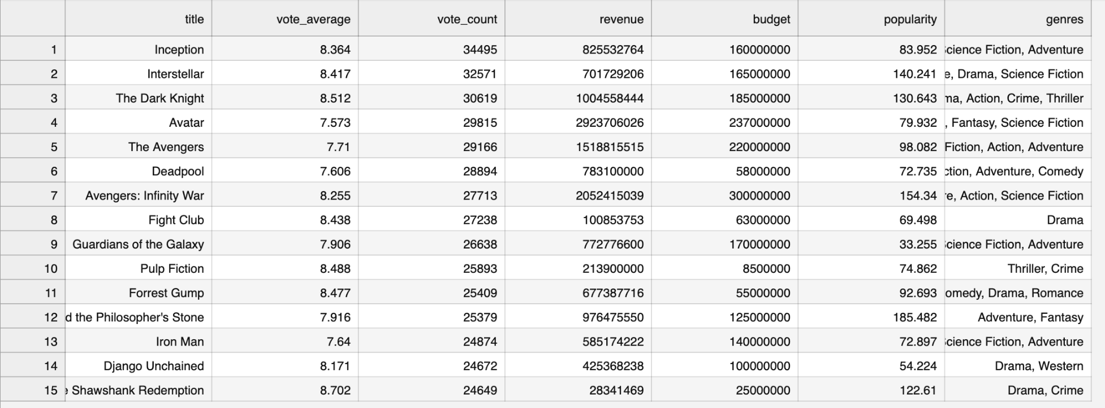
Result
The correlation between revenue, budget, vote count, popularity, and genre

